Slide 1
Final Presentation
Group 1:
Jibin Mathews Maritza Torres

Slide 2
Objective
Make a course for the Lab 1 Group that is heavy on sensing and signaling.
Rover must complete the course in 60 seconds
Track Position of Rover and Determine speed required to finish on time
Course communication for various actions
IR and Sound

Slide 3
Track Elements
Utilize Metallic Strip as path for rover to follow
Use IR Sensor and Sound Communication to Decode/ Encode Information with Rover
Track Rovers location

Slide 4
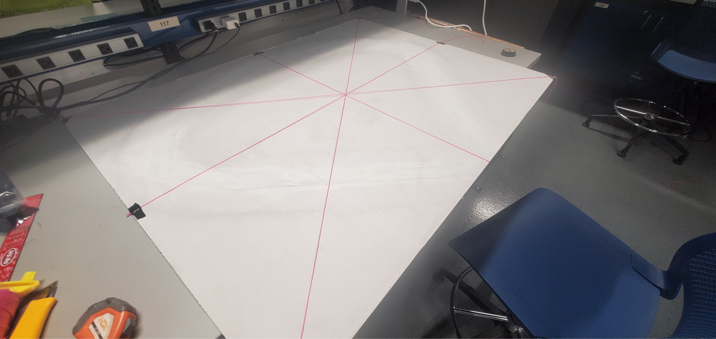
Measuring Dots

Slide 5
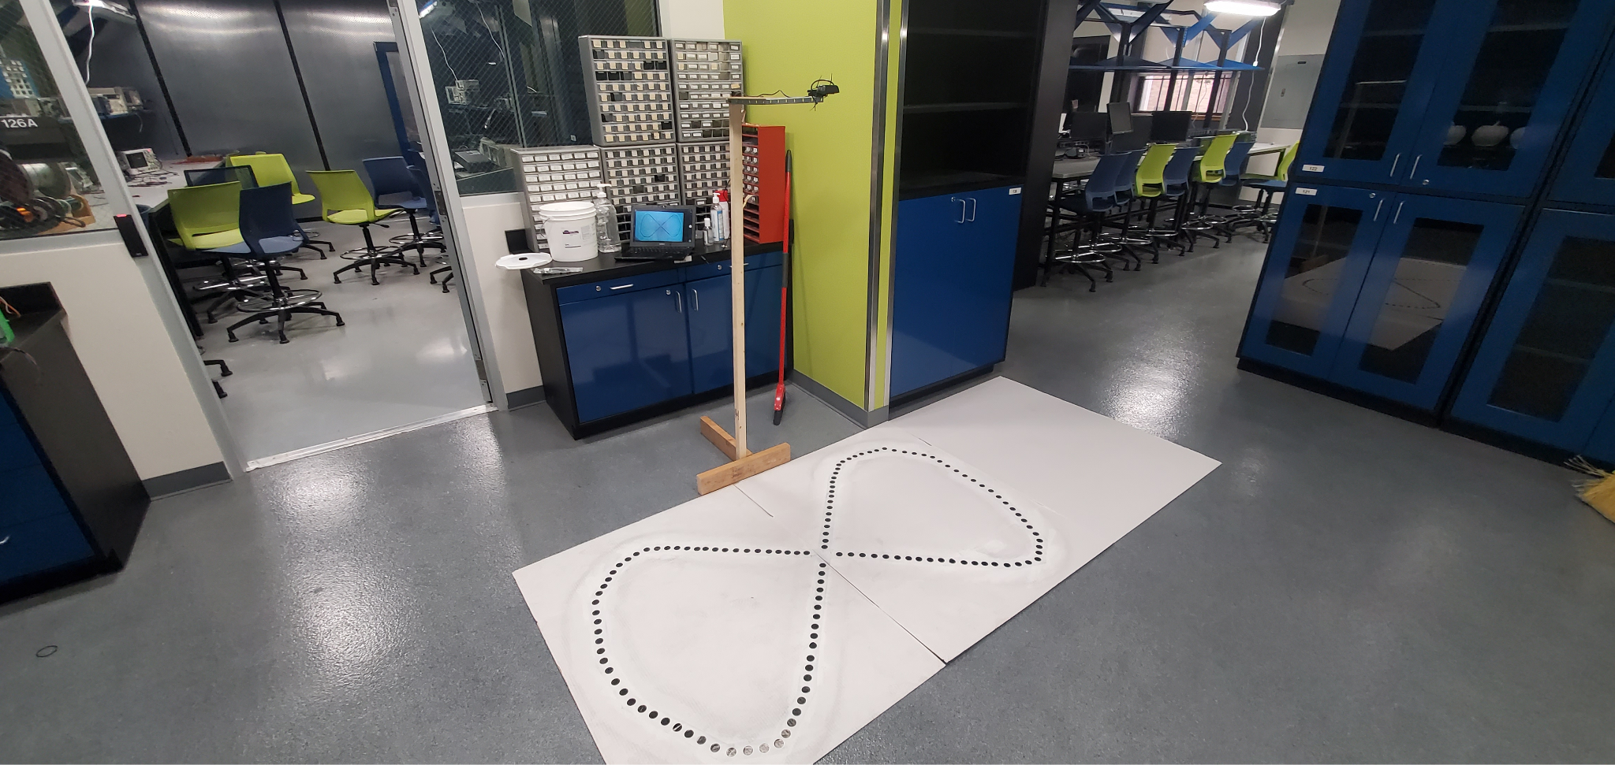
Final Track with Arm

Slide 6
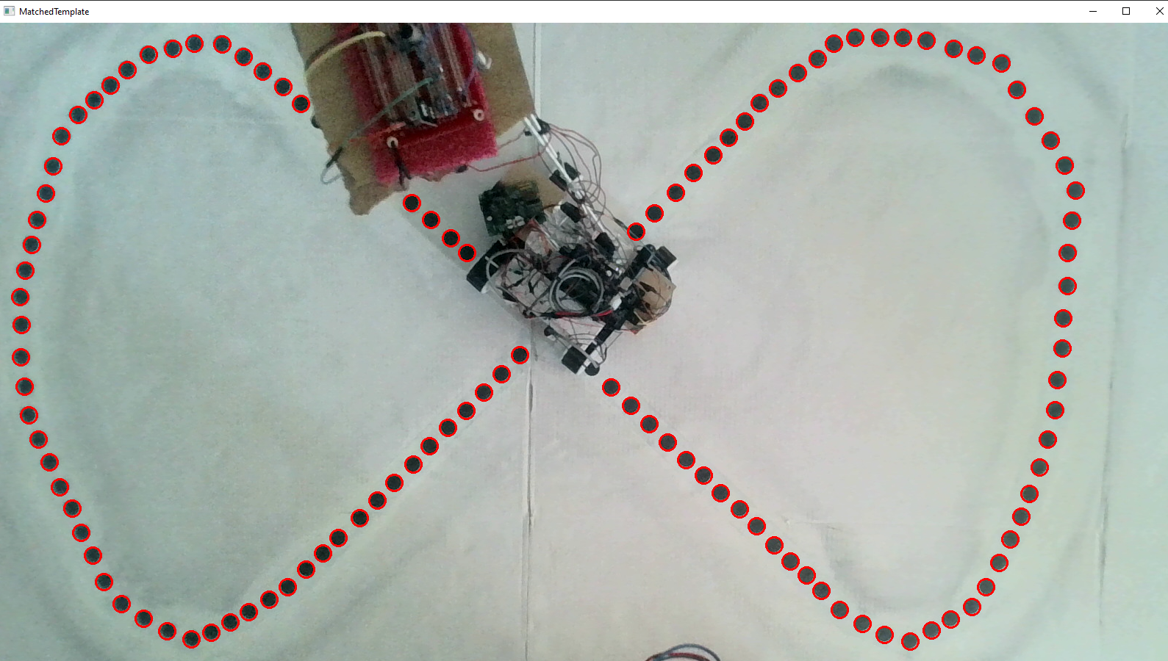
Tracking
Notes:
Intersection Over Union

Slide 7
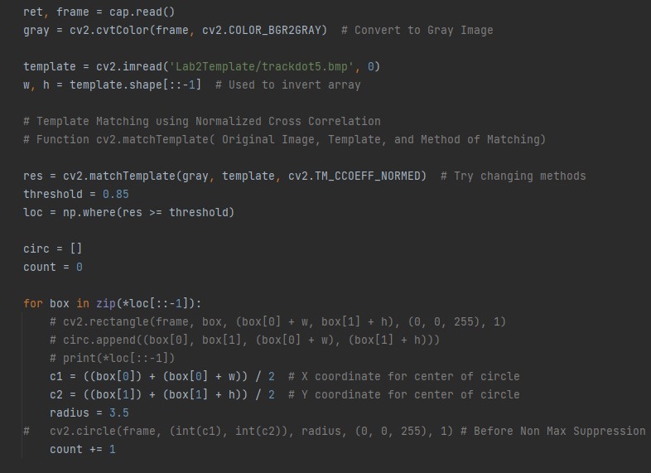
Template Matching

Slide 8
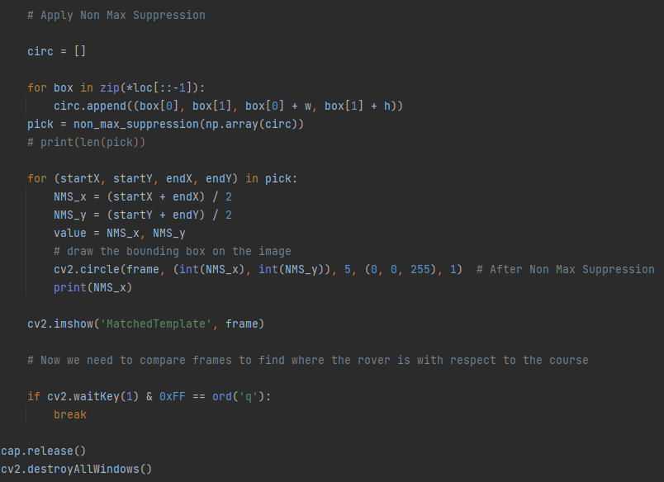
Applying Non Maximum Suppression
Notes:
Intersection over union

Slide 9
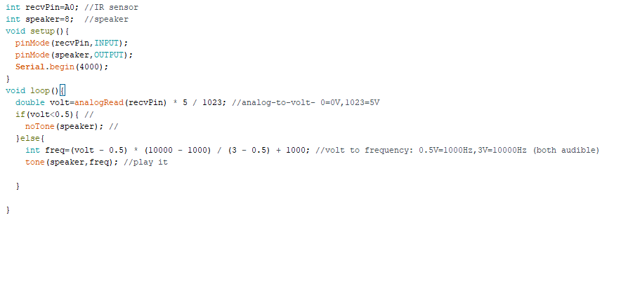
Snippet of Code for IR Sensor using Arduino IDE

Slide 10
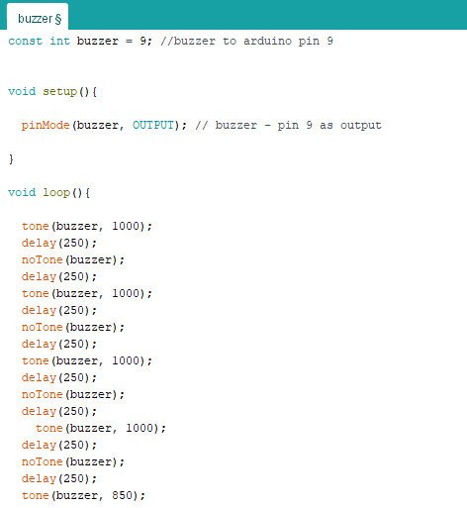
Buzzer Code

Slide 11
Budget
Budget Lab 2 Project | Cost: | Total Spent:
Raspberry Pi 4 Model B | $129.99 | $0.00 |  | Material Costs | Cost: | Total Spent:
IR Receiver Module | $7.40 | $7.40 |  |  | $270.84 | $125.85
Misc. (LED, Resistors, Jumper wires) | $10.00 | $10.00
Onn. Webcam | $27.00 | $27.00 |  | Totals | Total Cost: | Actual Cost:
Elegoo Uno R3 (arduino) | $16.99 | $16.99 |  |  | $270.84 | $125.85
Buzzer | $1.04 | $1.04
USB Type B - A cable connector | $29.99 | $29.99
Breadboards | $9.99 | $9.99
Track Elements
Whiteboard | $13 | $13.00
Metallic Tape | $10.00 | $10.00
Wood | $15.00 | $15.00

Slide 12
References
https://www.aatc.tw/products.php?lang=en&id=635
Nayar, S. K. (2021, March 1). Template matching by Correlation | Image processing I. YouTube. Retrieved July 12, 2022, from https://www.youtube.com/watch?v=1_hwFc8PXVE&ab_channel=FirstPrinciplesofComputerVision
Tomasi, C., & Manduchi, R. (n.d.). Bilateral filtering for gray and color images. IEEE Xplore. Retrieved July 12, 2022, from https://ieeexplore.ieee.org/document/710815
Wilhelm, M., Nutter, B., Long, R., & Antani, S. (n.d.). Linear Array image analysis for automated detection of human papillomavirus. IEEE Xplore. Retrieved July 12, 2022, from https://ieeexplore.ieee.org/abstract/document/5255266
https://wiki.dfrobot.com/DIGITAL_IR_Transmitter_Module__SKU_DFR0095_
S. K, “Non-maximum suppression (NMS),” Medium, 30-Apr-2021. [Online]. Available: https://towardsdatascience.com/non-maximum-suppression-nms-93ce178e177c. [Accessed: 02-Aug-2022].

Slide 13
Questions
?

